Slide 1
Steps of Hypothesis Testing
Step 1: State the Hypotheses
Write out the null and alternative hypotheses
In words and symbols unless otherwise specified

Slide 2
Steps of Hypothesis Testing
Step 2: Select the Statistical Test and the Significance Level
One-sample z-test: comparison of one sample mean to a population mean when the population standard deviation is known
We will learn other tests
Typically set alpha at .05; two-tailed test (non-directional)
Alpha is the area in the null distribution we define to be unlikely
Two-tailed tests are more conservative than one-tailed (preferred method unless explicitly told otherwise)

Slide 3
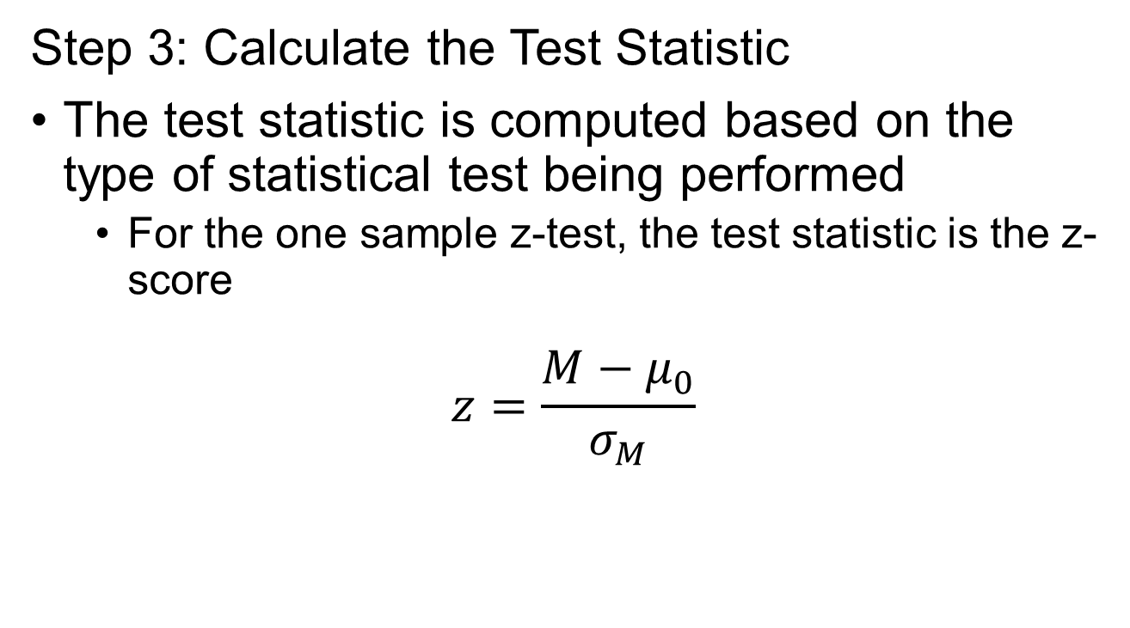
Steps of Hypothesis Testing
Step 3: Calculate the Test Statistic
The test statistic is computed based on the type of statistical test being performed
For the one sample z-test, the test statistic is the z-score
$$z=\frac{M−μ_{0}}{σ_{M}}$$

Slide 4
Steps of Hypothesis Testing
Step 4: Make a decision
Two approaches:
Find the critical value & define the rejection region:
The rejection region is the region in the tail(s) that have an area exactly equal to alpha
If our test statistic (Z) is more extreme than the critical value, it falls into the rejection region (and we reject the null)
Determine the p-value
The p-value is the probability of finding a test statistic more extreme than the one obtained
If our p-value is less than alpha (typically, .05), we reject the null

